Slide 1














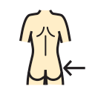






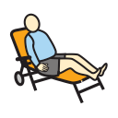
























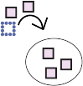











































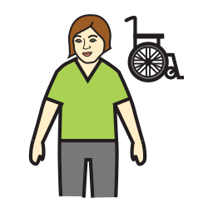





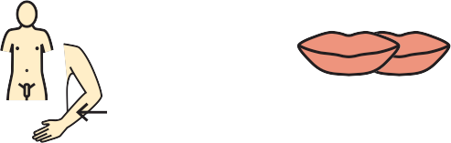

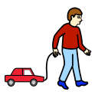











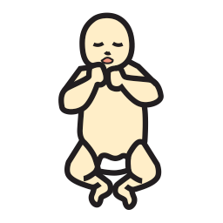






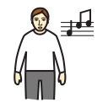




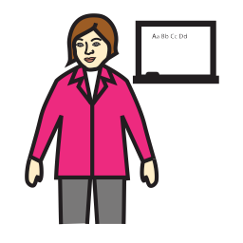








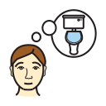




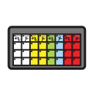
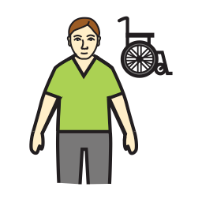
































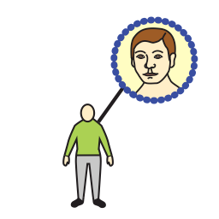
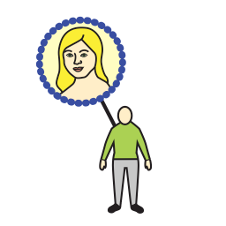














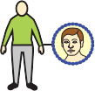
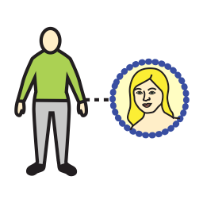



















































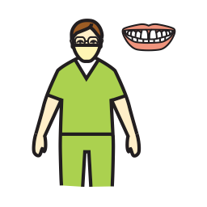





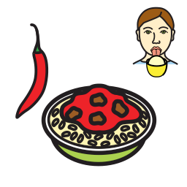



I’ll spell it ABC | A | B | C | D | E | F | G | H | I | J | K | L | M | N
yes | I like | hello | I want to talk to you | I’m fine | Ok | not so good | please | Thank you | sorry | excuse me | maybe | really | I don’t know | but
My name ------------ | I | I’m ‘m | leave me alone | lucky | chill out | go away | loser | WOW ! | minga | You’re doing my head in | whatever | no way | shut up | well
I live in ------------ | me | my | colour | light | dark | shape | opposite | feeling | hungry | afraid | safe | busy | dry | wet
My birthday ------------ | mine | we/us | all gone/ done finished | more | nice | wrong | right | It is | hungry | funny | good | happy |  | fast
My age ------------ | they/them | it | problem | pretty | mean | different | same | I am | tired | angry | sad | sick | medium | big
I Live with --------------- | you(r) | people | favorite | important | because | idea | board | hot | cold | bad | scared | confused | soft | easy
My pet ------------ | he/him/his | she/her/hers | go | do | help | look | see | eat | feel | read | sit | stand | kiss | are
College ----------- | man | woman | stop | come | get | give | think | wait | watch | work | have | know | find | hear
Email ----------- | baby | child | like | listen | make | put | tell | play | sing | sleep | talk | try | ride | say
Work --------- | Ed staff | friend | take | turn | open | close | want | win | loose | finish | need | drink | wash | write
Com/AAC -------------- | Support staff | job | food | lunch | meal | meat | veg | fruit | fast food | snack/ pud | sauce/ing | salad | drinks | time
Music ------------ | class | Family | breakfast | sandwitch | lasagna | fish | Potato | apple | chips | raison | ketchup | tomato | hot drink | today
Film ------------ | Dad | Mum | cereal | crackers | spaghetti | bacon | broccoli | banana | burger | ice cream | mayo | cucumber | milk | morning AM
Hobbies ------------ | sister | brother | porridge | cheese | pasta | beef | carrot | grapes | pizza | crisps | salt/ pepper | pepper | water | again
TV ------------ | grandma | grandpa | toast | beans | stew | tuna | peas | lemon | hot dog | cake | gravy | Lettuce | juice | place
disability ------------ |  |  | butter | soup | roast | ham | mushroom | orange | sweet | chocolate | sugar | beetroot | milkshake | work
mobile ----------- |  |  | egg | pie | Chinese | chicken | onion | pear | candy floss | cream | jam | olives | alcohol | dentist
 |  |  | cooked breakfast |  | curry | sausage | cauli | berries |  |  | spices | chilli | straw | library

Slide 2





















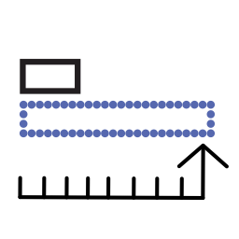
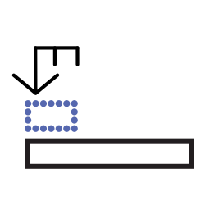






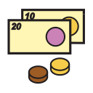













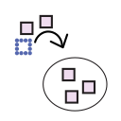













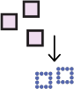









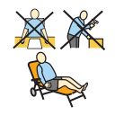



















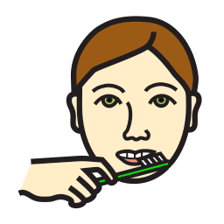







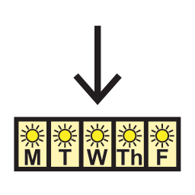
















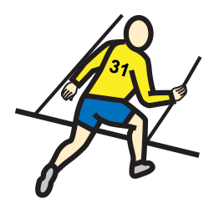






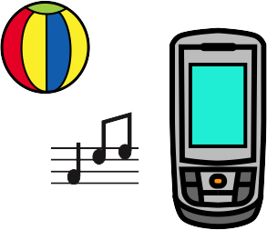





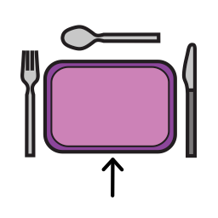





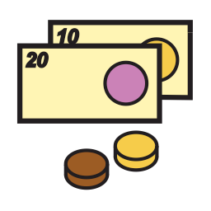









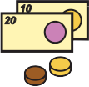











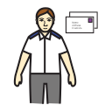





O | P | Q | R | S | T | U | V | W | X | Y | Z | mistake | New word
so so | Ouch | I love u | cool | goodbye | no symbol | Are you ignoring me? | U on earth to anoying me? | Question ? | Your news? | Can I see? | Do you | I don’t like | No
miss you | Happy Bday! | get well soon | congrats | take care | fun | A lot | part | Why | When | who | where | don’t | Not
tall | long | short | top | up | down | in | out | which | how | How are you? | How much? | could | Your name?
slow | loud | quiet | middle | here | there | on | off | What | What’s that? | What next? | What doing? | would | You live?
little | new | old | bottom | under | over | this | that | What think? | Want more | Dinner? |  | should | your Birthday?
hard | clean | dirty | full | empty | all ll | some | none | To | from | about | with | away | Your age?
buy | can | count 1234 | I want | Go outside | Call someone | is | and & |  | toilet | I need help | I’m ill | pain | You live with?
hold | let | live | Something else | my turn | holiday | be | at @ |  | relax | shave | meds | wipe face | Your pets?
share | walk | was | cook | go home | Listen to music | am | a |  | do nails | shower | bath | Problem with | Your School?
break | ask | love | swim |  |  | the |  |  | change | clean glasses | do hair | clean teeth | Your email?
day | night | tonight | Special day | Week | Weekend | This week | Next week | Month | January | February | March | April | Your job?
yesterday | tomorrow | later | late | Mon M | Tues T | Wed W | Thurs Th | Friday F | May | June | July | Aug | Your ♯?
afternoon PM | evening PM | now | never | Sat S | Sun Su |  |  |  | Sept | Oct | Nov | Dec | Films?
ready | hurry | before | after |  |  | It’s about | art and craft | health | body parts | garden | thing(s) | leisure | Your hobbies?
outside | my day place | shop | my room |  |  | clothes | computer | furniture | toys | kitchen | stuff | TV | Do you watch TV?
school | town | hospital | airport |  |  | money | office | sport | things that help | toiletries | bag | MP3 | phone
pool | restaurant | bank | doctor |  |  | tools | transport | nature | animal | Weather | camera | photo | DVD
cinema | home | pub | post office |  |  | fire | battery | candle | tablet | charger | book
ask

